Slide 1
Adapting to Parenthood

Slide 2
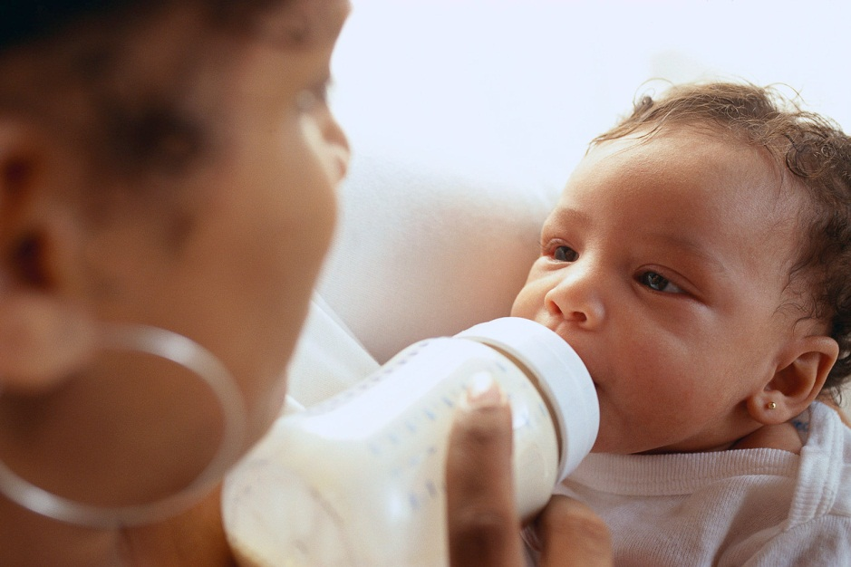
The Amazing Newborn
Use their senses to learn about their new world
Sensitive to:
Strong light
Sounds
Strong smells
Cry to signal:
Hunger
Attention
Diaper change

Slide 3
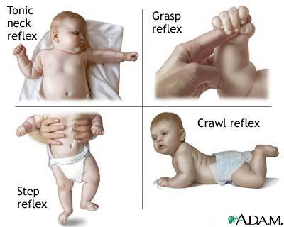
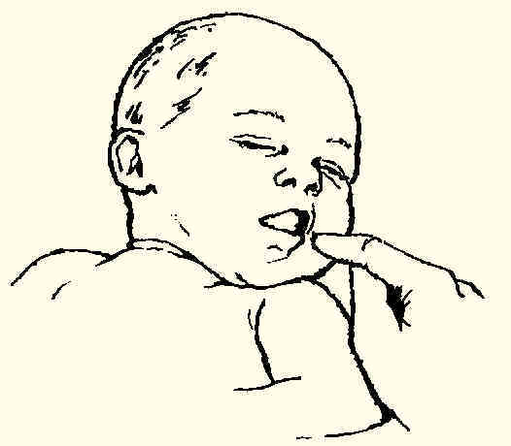
Newborns Reflexes
Instinctive automatic responses
Involuntary → voluntary
Sneezing & swallowing continue throughout life
Reflexes that last until voluntary control is developed:
Rooting
Grasp
Startle

Slide 4
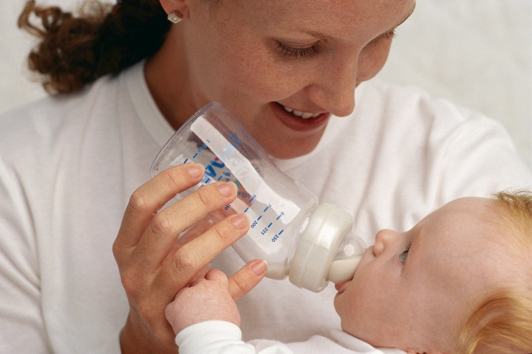
Caring for Newborns
Feeding
Every 2-3 hours
Sleeping
Average of 15 hours per day
Exercise
Actively moving arms and legs to gain strength and control
Safe, clean, and warm
Diaper and bathe
Close watch

Slide 5
Caring for Newborns
Medical Care
Periodic checkups to check development and receive immunizations
Sensory Stimulation
Look, touch, listen, and play
Love
Close contact with warm, affectionate adults

Slide 6
Understanding the Baby’s Language
One way to communicate= CRYING
Average newborn cries one hour per day
Parents begin to recognize their babies different cries

Slide 7
Early Temperament
Style of reacting to the world and relating to others

Slide 8
Sudden Infant Death Syndrome
SIDS Topic Extension Project

Slide 9
Shaken Baby Syndrome
Shaken Baby Syndrome Topic Extension Project

Slide 10
Parents Needs
Knowledge of how to care for an infant
Resources
Time
Financial planning

Slide 11
Post Natal Care of the Mother
Natural for most of the attention to be focused on baby
New mothers have specific physical and emotional needs
Doctor or nurse discuss these needs before mother and baby go home

Slide 12
Recovery After Childbirth
Physical Needs
Recover from pregnancy and birth
Regain fitness
About 12 pounds is lost during birth (baby, placenta, fluids)
4 pounds by the end of 1st week (water weight)
Takes a few months
Must take of herself in order to properly take care of baby

Slide 13
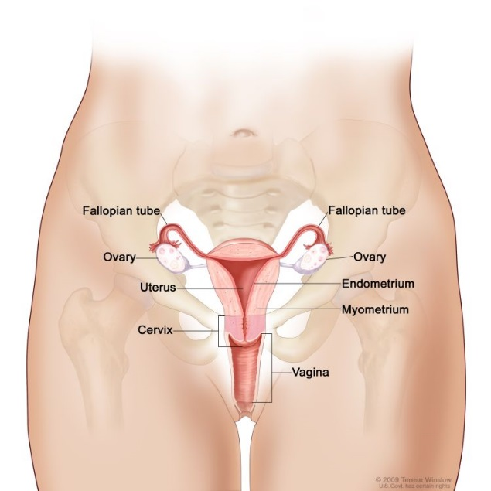
Recovery After Childbirth
Uterus
Shrinks back to its previous size and location
May feel it contracting
As uterus shrinks, abdomen tightens
Fluid
Additional fluid stored during pregnancy
New mothers perspire more and urinate more to rid the excess fluid

Slide 14
Recovery After Childbirth
Physical Needs
Rest
Exercise
Nutrition
Medical Checkup
4-6 weeks after birth
Postnatal checkup
Check uterus and any problems

Slide 15
Recovery After Childbirth
Postnatal Care (after childbirth)
Rest and sleep
Nutrition
Postnatal checkup
Exercise

Slide 16
Postnatal Care of The Mother
Emotional Needs
Having a baby is joyous, but stressful
Hormones- the body’s powerful chemical messgengers
Shift
Many new mothers go through mild depression
New fathers may have these feelings too
Parents should:
Talk about feelings
Seek support
Get needed sleep
Avoid isolation

Slide 17
Challenges for New Parents
Adapting to Routines
New patterns of life
Round the clock care
Sleep
Feeding
Diaper changing

Slide 18
Challenges for New Parents
Handling Mixed Emotions
Gaining Confidence
Time and practice
Strengthening the Parent-Child Bond
Managing Multiple Roles
Set priorities
Use time efficiently
Get organized
Manage stress
Develop a Support System

Slide 19
Couples As Parents
Adjust to new role as parents and continue to nurture their relationship
Sharing responsibilities
Discussing parenting philosophies
Making time for each other
Communicating as a couple

Slide 20
Helping Siblings Adjust
Involve siblings in baby’s care
Spend some time alone with each older child
Tolerate some babyish behavior
Praise more mature actions
Encourage siblings to talk about their feelings
Tell them that they are loved

Slide 21
Parenting
If more serious or longer lasting depression:
Post Partum Depression Topic Extension Project

